Slide 1

PROTECTION: Root-of-Trust for IO in Compromised Platforms
Aritra Dhar, Enis Ulqinaku, Kari Kostiainen, Srdjan Capkun
ETH Zurich

Slide 2



Motivation
Remote device
Heart beat
75
Insulin (U)
177
Basal rate (U/Hr)
0.025
Low limit (mg/dL)
60
High limit (mg/dL)
105
Program
Cancel

Slide 3








Remote Trusted path
User
HIDs
Host
Remote server

Slide 4







Solution 1: Transaction Confirmation Device
Remote device
Heart beat
75
Insulin (U)
177
Basal rate (U/Hr)
0.025
Low limit (mg/dL)
60
Android Protected Confirmation
You are going to program
Heart beat 75
Insulin 177U
Basal rate 0.025 U/Hr
Low level 60 mg/dL
High level 105 mg/dL
And more ……
High limit (mg/dL)
105
Program
Cancel

Slide 5


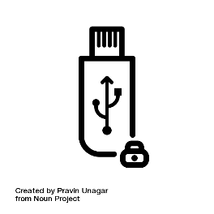
Solution 2: Input Signing
Remote device
Heart beat
75
Insulin (U)
177
Heart beat 75
Insulin 177U
Basal rate 0.025 U/Hr
Low level 60 mg/dL
High level 105 mg/dL
Basal rate (U/Hr)
0.025
Low limit (mg/dL)
60
Trusted embedded device
High limit (mg/dL)
105
Program
Cancel

Slide 6




IntegriKey – Display manipulation attack
177
177
Insulin
1777
$$←$$
17
Insulin
177
User sees 177
Device records 17
Host sends 17

Slide 7
Observation 1
The lack of output integrity – the render of user inputs on the screen – compromises input integrity.

Slide 8

Solution 3: Overlay
Remote device
Remote device
Heart beat
75
Heart beat
Insulin (U)
177
Insulin (U)
Basal rate (U/Hr)
0.025
Basal rate (U/Hr)
Low limit (mg/dL)
60
Low limit (mg/dL)
High limit (mg/dL)
105
High limit (mg/dL)
Program
Cancel
Program
Cancel

Slide 9
Overlay: Output Manipulation
Remote device
Heart beat
Insulin (U)
Basal rate (U/Hr)
Low limit (mg/dL)
High limit (mg/dL)
Program
Cancel

Slide 10
Overlay: Output Manipulation
Remote device
Insulin (U)
Heart rate
Basal rate (U/Hr)
Low limit (mg/cc)
High limit (mg/cc)
Program
Cancel

Slide 11

Overlay: Output Manipulation
Remote device
Insulin (U)
177
Heart rate
75
Basal rate (U/Hr)
0.025
Low limit (mg/cc)
6000
High limit (mg/cc)
10500
Program
Cancel

Slide 12

Overlay: Output Manipulation
Remote device
Insulin (U)
177
Heart rate
75
Basal rate (U/Hr)
0.025
Low limit (mg/cc)
6000
High limit (mg/cc)
10500
Program
Cancel

Slide 13
Observation 2
If the protected output is provided out-of-context,
users are more likely not to verify it.
Therefore input integrity can be violated.

Slide 14
Overlay: Early Form Submission Attack
Remote device
Heart beat
75
Textbox in focus
Insulin (U)
17
Basal rate (U/Hr)
0.025
Low limit (mg/dL)
60
High limit (mg/dL)
105
OS triggers click
Program
Cancel

Slide 15
Observation 3
If not all the modalities of inputs are secured simultaneously, none of them can be fully secured.

Slide 16





Requirements

Slide 17







ProtectIOn
IOHub

Slide 18
IO Integrity – Overlay Generation
Remote device
Insulin (U)
Heart rate
Basal rate (U/Hr)
Low limit (mg/cc)
High limit (mg/cc)
Program
Cancel
<form action=“/some_action”, signature = “0x45AB…”, id = “0x0ab”>

Slide 19
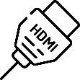
IO Integrity – Overlay Generation
Remote device
Verified UI from secure_site.io
Insulin (U)
Heart rate
Basal rate (U/Hr)
Low limit (mg/cc)
High limit (mg/cc)
Program
Cancel

Slide 20

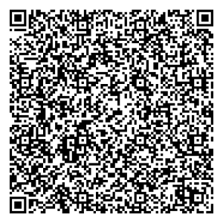

IO Integrity – Input
Remote device
Verified UI from secure_site.io
Insulin (U)
75
Heart rate
177
Basal rate (U/Hr)
0.025
Low limit (mg/cc)
60
High limit (mg/cc)
105
Program
Cancel

Slide 21
Grabbing User Attention
Output Integrity: Low cognitive load
Several existing mechanisms

Slide 22
Grabbing User Attention
Output Integrity: Low cognitive load
Several existing mechanisms
Lightbox

Slide 23
Grabbing User Attention
Output Integrity: Low cognitive load
Several existing mechanisms
Lightbox
Highlight

Slide 24
Grabbing User Attention
Output Integrity: Low cognitive load
Several existing mechanisms
Lightbox
Highlight
Freezing

Slide 25
Grabbing User Attention
Output Integrity: Low cognitive load
Several existing mechanisms
Lightbox
Highlight
Freezing
Combination

Slide 26
Grabbing User Attention
Output Integrity: Low cognitive load
Several existing mechanisms
Lightbox
Highlight
Freezing
Combination
How to determine when to engage?
Track pointer
Mouse movement on the overlay

Slide 27
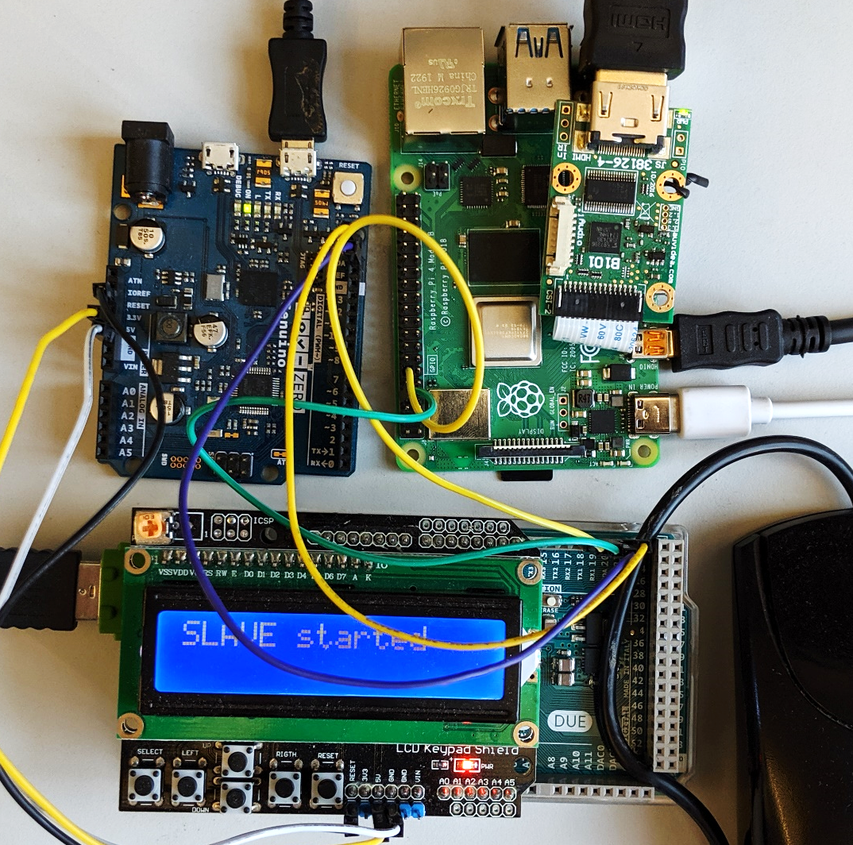










Prototype and TCB
25.16M
20.92M
1.9K
2M
3.5K
71K
3.5K
600K
121K
36.68M

Slide 28
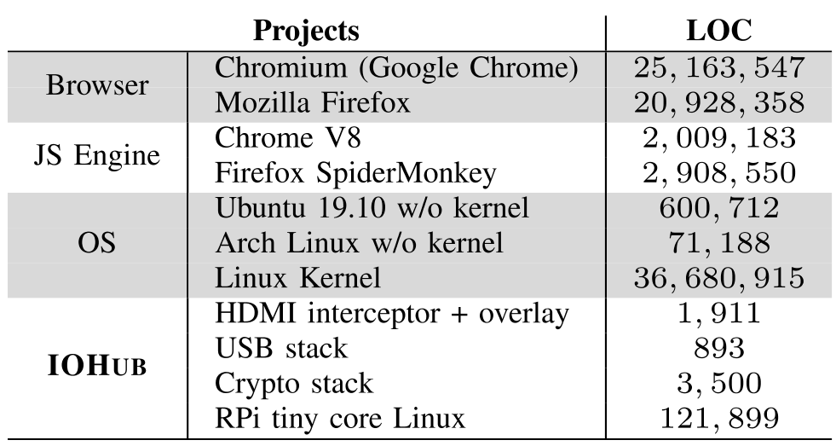
Prototype and TCB

Slide 29
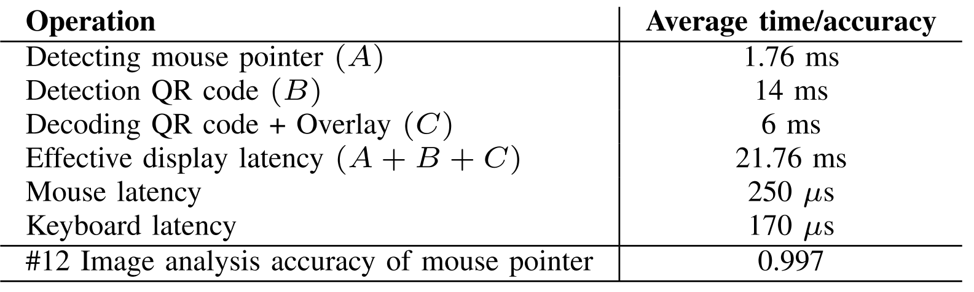
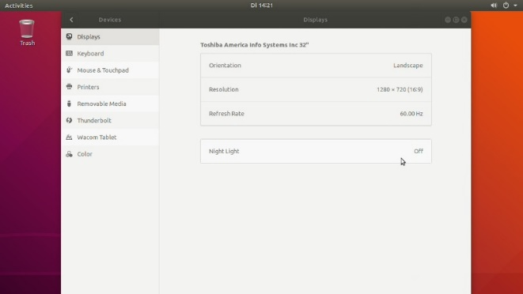
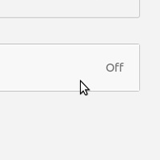
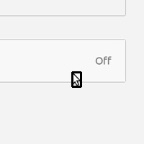
Performance

Slide 30


Thank you! Questions?

Slide 31
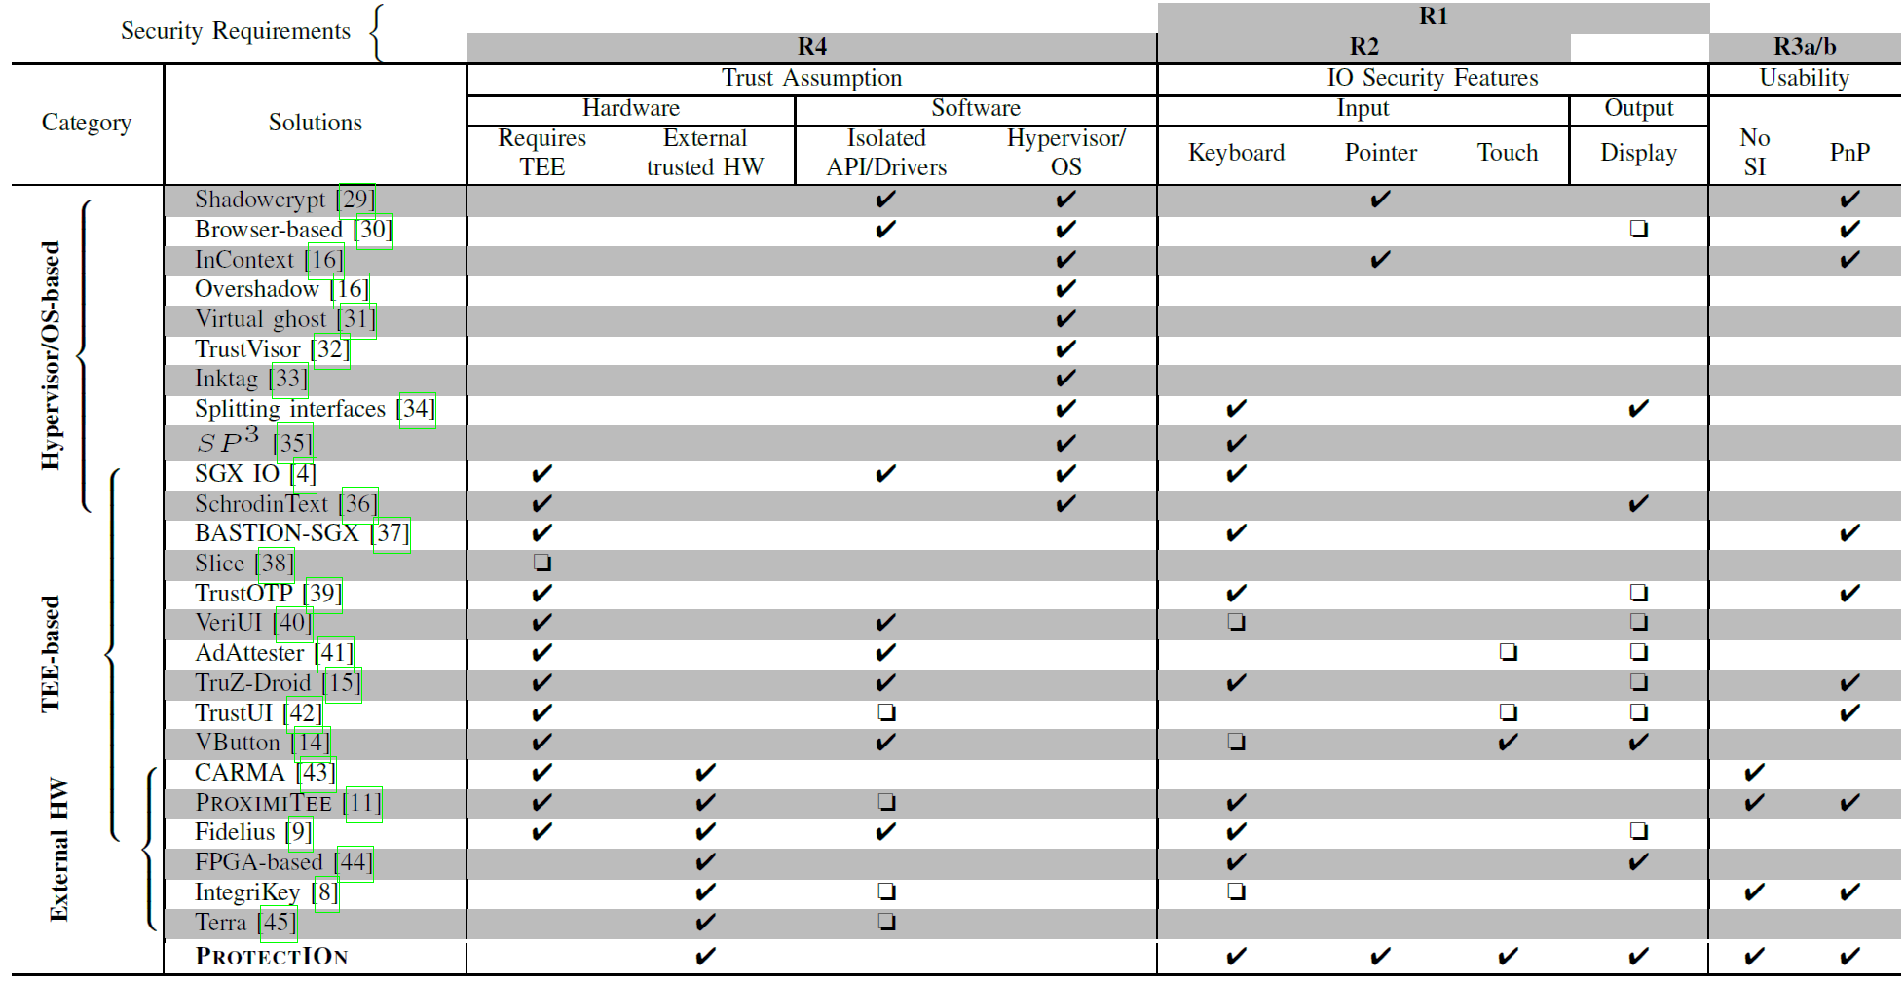
Other Trusted Path Solutions

Slide 32
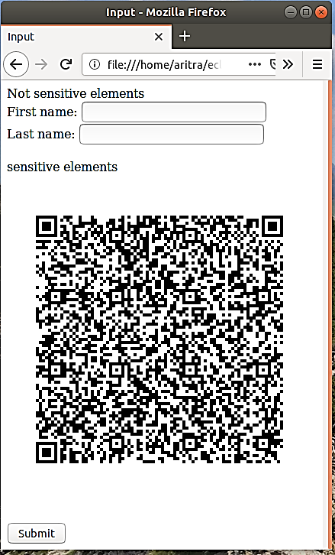
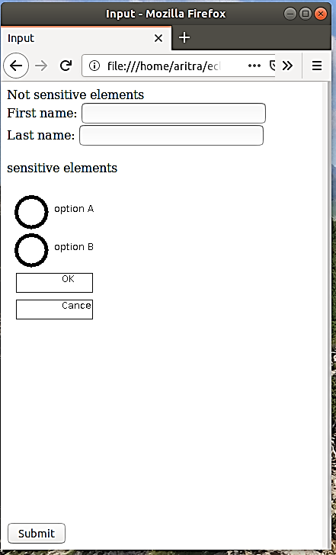
Approach Overview
Attacker’s view
User’s view on the monitor
Focusing user’s attention

Slide 33
Solution 3: Overlay
Remote device
Remote device
Heart beat
75
Heart beat
Insulin
30
Insulin
Program
Cancel
Program
Cancel

Slide 34
Backup slides

Slide 35
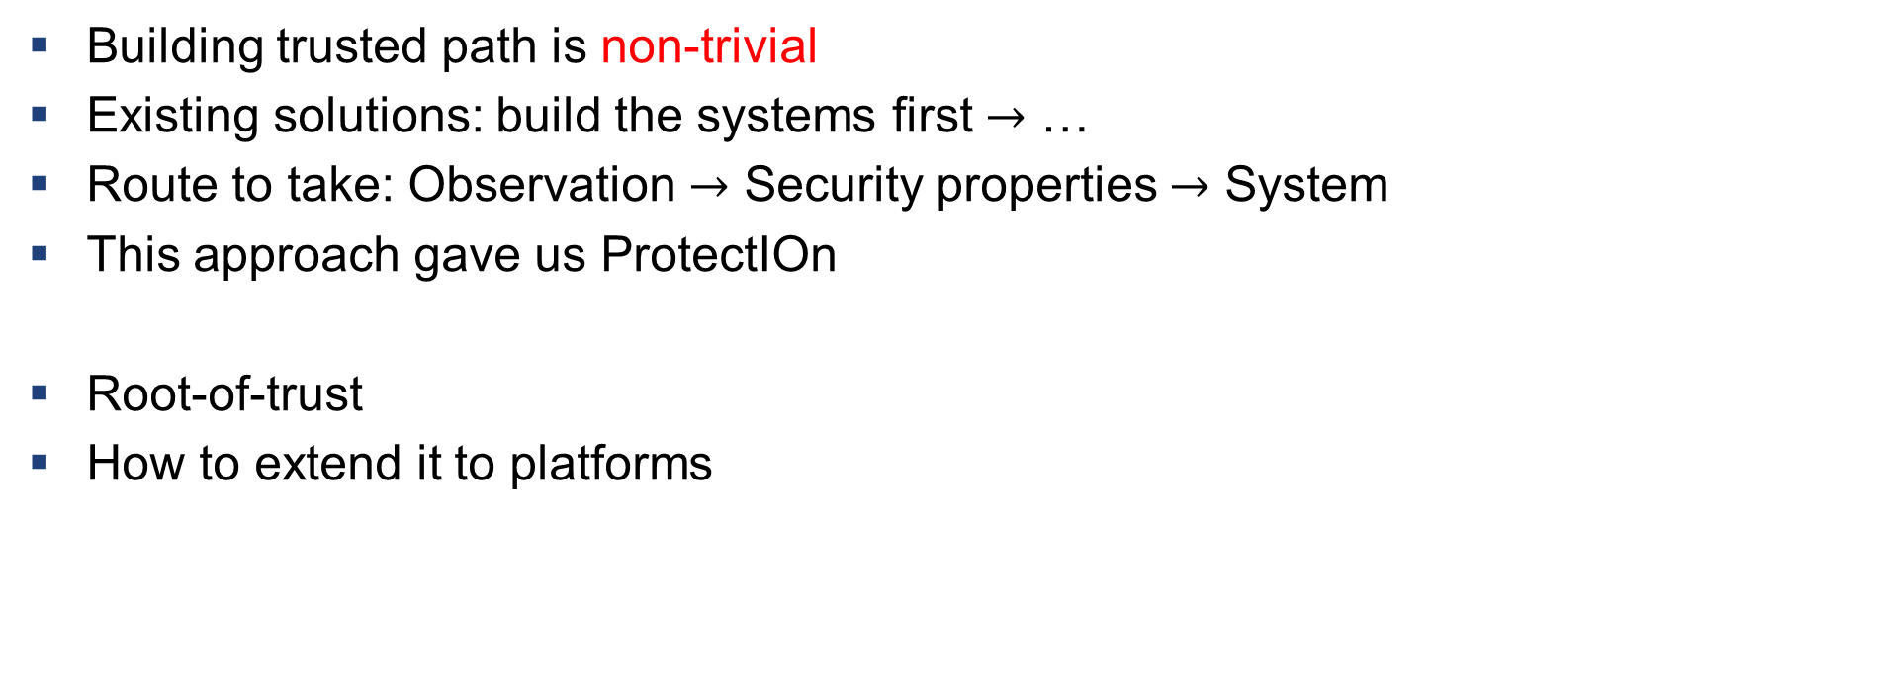
What we learnt?
Building trusted path is non-trivial
Existing solutions: build the systems first $→$ …
Route to take: Observation $→$ Security properties $→$ System
This approach gave us ProtectIOn
Root-of-trust
How to extend it to platforms

Slide 36
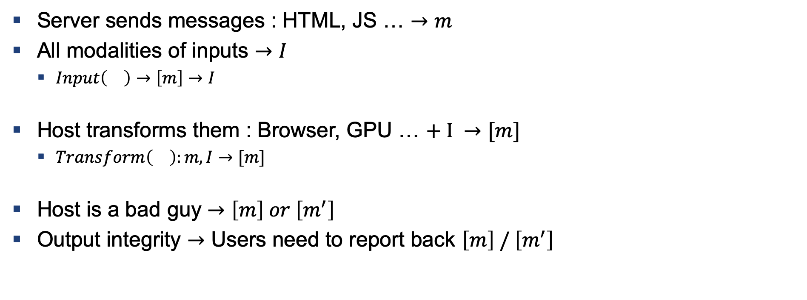
How to Build a Trusted Path
Server sends messages : HTML, JS … $→m$
All modalities of inputs $→I$
$Input\left(\right)→\left[m\right]→I$
Host transforms them : Browser, GPU … $+ I →[m]$
$Transform\left(\right):m,I→[m]$
Host is a bad guy $→\left[m\right] or \left[m^{′}\right]$
Output integrity $→$ Users need to report back $\left[m\right] / \left[m^{′}\right]$

Slide 37
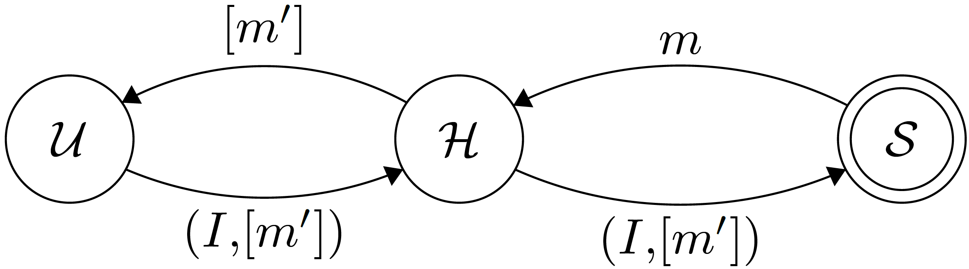
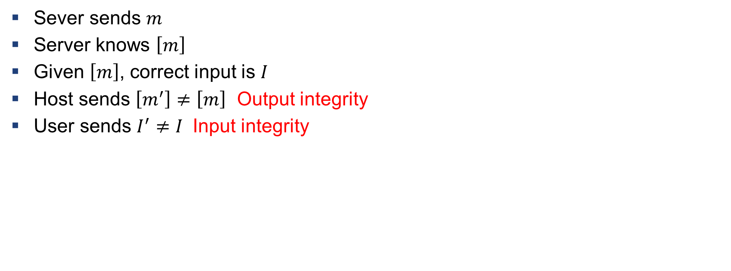
Definition: Violation of Input/output Integrity
Sever sends $m$
Server knows $\left[m\right]$
Given $\left[m\right]$, correct input is $I$
Host sends $\left[m^{′}\right]≠\left[m\right]$ Output integrity
User sends $I^{′}≠I$ Input integrity

Slide 38
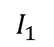
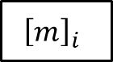
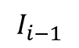
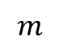
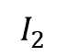
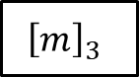
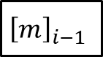
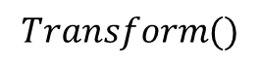
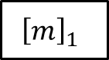
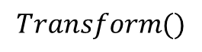
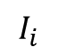
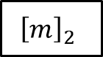

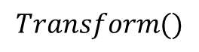
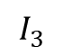
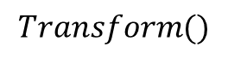
Verification
$$m$$
$$Transform()$$
$${\left[m\right]}_{1}$$
$${\left[m\right]}_{2}$$
$${\left[m\right]}_{3}$$
$${\left[m\right]}_{i−1}$$
$${\left[m\right]}_{i}$$
$$…$$
$$I_{1}$$
$$I_{2}$$
$$I_{3}$$
$$I_{i−1}$$
$$I_{i}$$
$$Transform()$$
$$Transform()$$
$$Transform()$$
Anything missing in the chain $→$ IO integrity violation

Slide 39
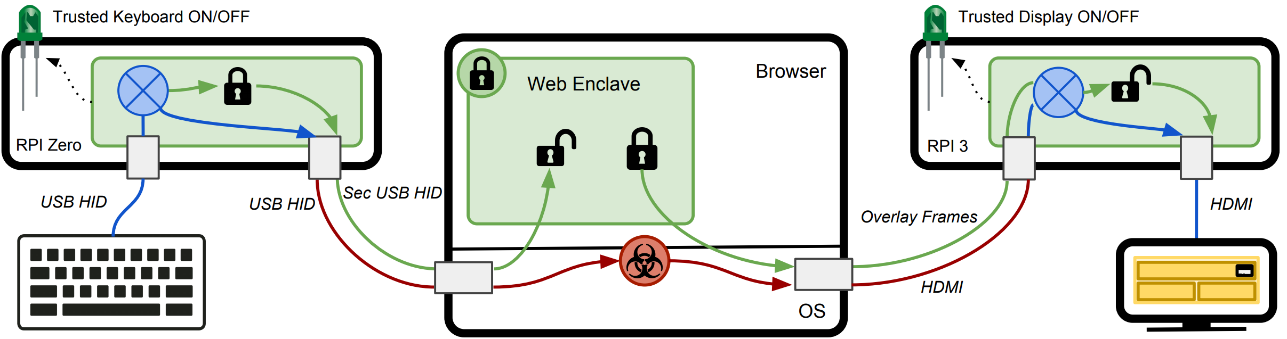
Fidelius – Output Integrity
Fidelius: Protecting User Secrets from Compromised Browsers, Saba Eskandarian et al., S&P 2018

Slide 40
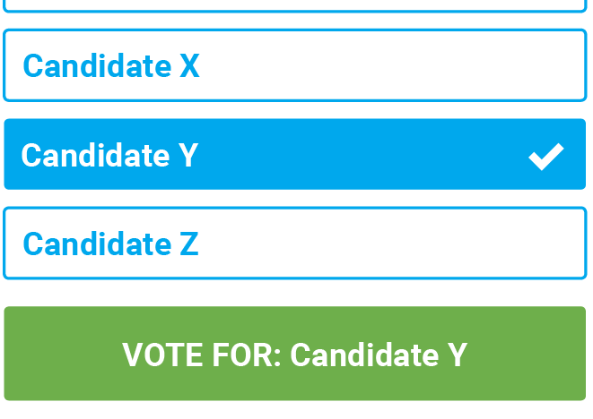
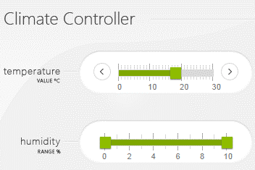
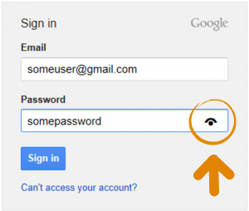
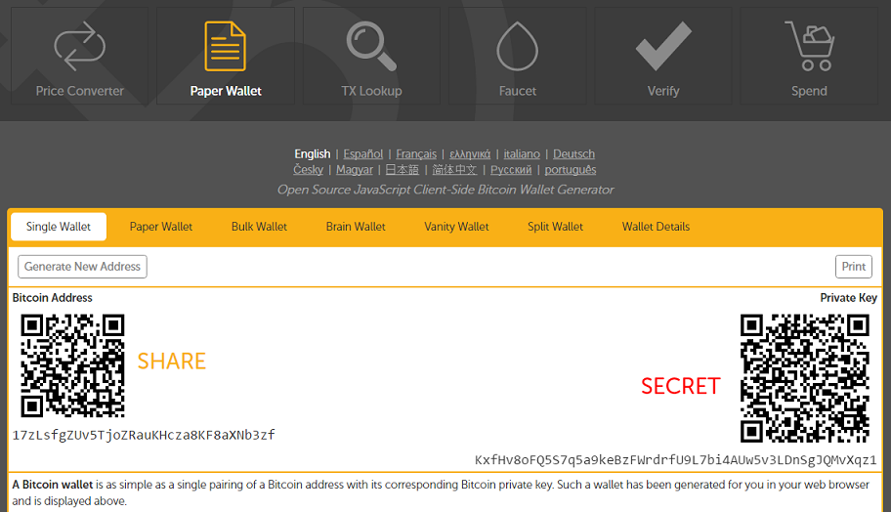
Motivation

